Slide 1
Learning Objective
I will be able to use the rules of derivative to differentiate functions.
Success Criteria
At the end of the lesson, I will be able to:
Apply the rules of derivative to differentiate functions.

Slide 2

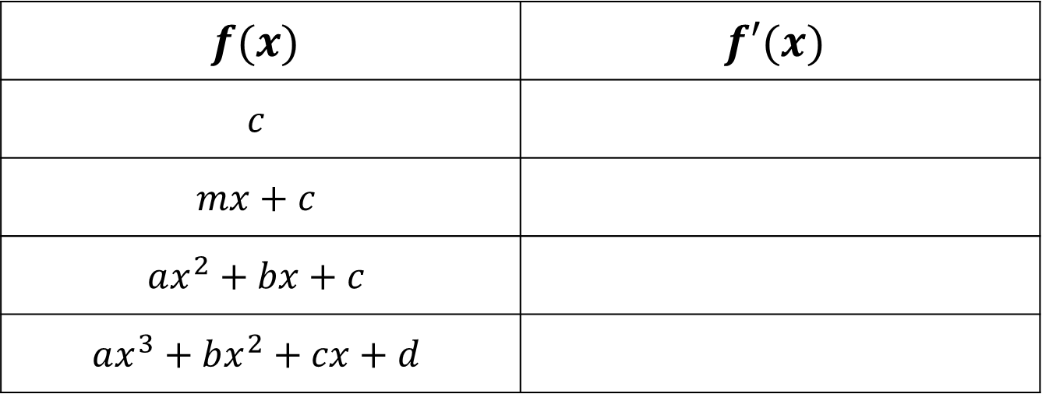



Rules of Derivative
Activating Prior Knowledge
$$f(x)$$ | $$f′(x)$$
$$c$$
$$mx+c$$
$$ax^{2}+bx+c$$
$$ax^{3}+bx^{2}+cx+d$$
$$0$$
$$m$$
$$2ax+b$$
$$3ax+2bx+c$$

Slide 3
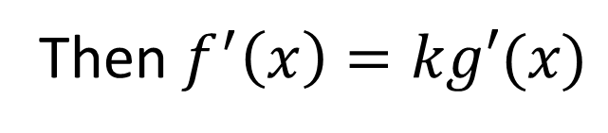
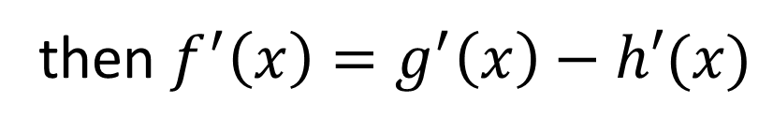
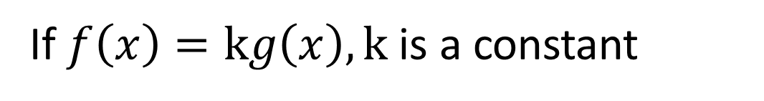
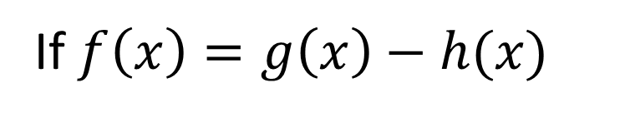
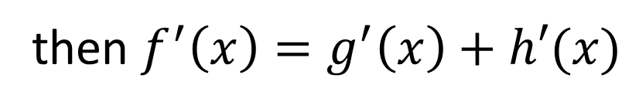
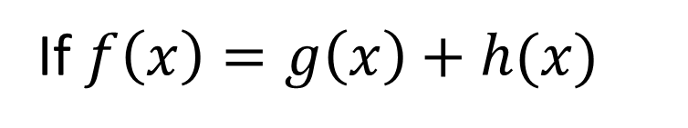
Multiplication rule by constant
Activating Prior Knowledge
If $f\left(x\right)=kg\left(x\right), k$ is a constant
Then $f^{′}\left(x\right)=kg′(x)$
Sum rule
If $f\left(x\right)=g\left(x\right)+h(x)$
then $f^{′}\left(x\right)=g^{′}\left(x\right)+h′(x)$
Difference rule
If $f\left(x\right)=g\left(x\right)−h(x)$
then $f^{′}\left(x\right)=g^{′}\left(x\right)−h′(x)$

Slide 4
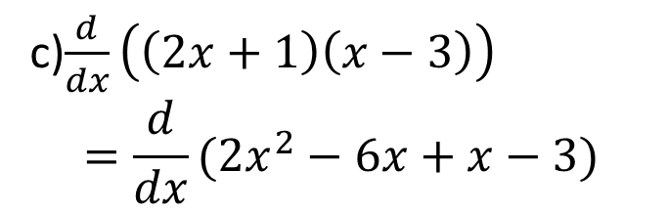
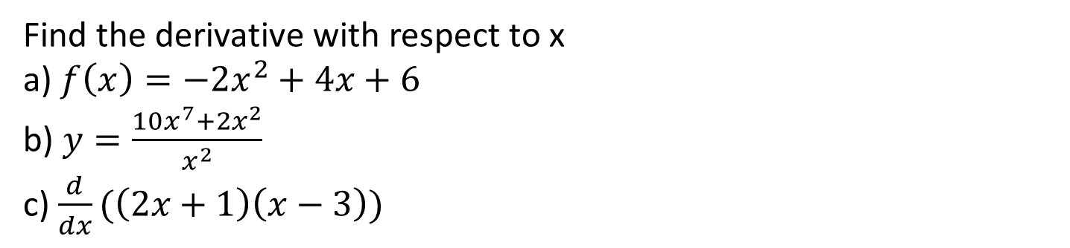
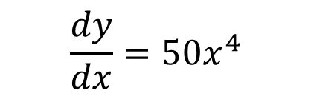

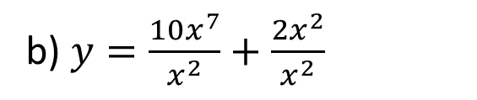

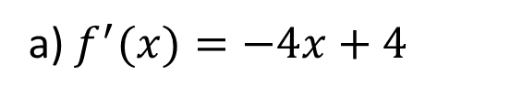
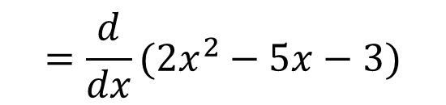
Guided Practice
Find the derivative with respect to x
a) $f\left(x\right)=−2x^{2}+4x+6$ b) $y=\frac{10x^{7}+2x^{2}}{x^{2}}$ c) $\frac{d}{dx}(\left(2x+1\right)\left(x−3\right))$
a) $f^{′}(x)=−4x+4$
c)$\frac{d}{dx}\left(\left(2x+1\right)\left(x−3\right)\right)$ $$=\frac{d}{dx}(2x^{2}−6x+x−3)$$
b) $y=\frac{10x^{7}}{x^{2}}+\frac{2x^{2}}{x^{2}}$
$$y=10x^{5}+2$$
$$=\frac{d}{dx}(2x^{2}−5x−3)$$
$$\frac{dy}{dx}=50x^{4}$$
$$=4x−5$$

Slide 5




Guided Practice
For the curve determined by the rule $f\left(x\right)=−2x^{3}−3x^{2}+2$, find the gradient of the tangent line to the curve at the point $(2,−26)$
$$f^{′}\left(x\right)=−6x^{2}−6x$$
$$f^{′}(2)=−6{\left(2\right)}^{2}−6(2)$$
$$=−36$$
The gradient is $−36$

Slide 6




Guided Practice
Find the coordinates of the points on the curve, $f\left(x\right)=x^{3}−3x^{2}$ with gradient $=0$
$$f^{′}\left(x\right)=3x^{2}−6x$$
Substitute $f^{′}\left(x\right)=0, 0=3x^{2}−6x$
$$3x\left(x−2\right)=0$$
$$x=0, x=2$$
$$\text{Substitute} x=0 into f\left(x\right), f\left(0\right)=0$$
$$\text{Substitute} x=2 into f\left(x\right), f\left(2\right)=2^{3}−3{\left(2\right)}^{2}$$
$$=8−12=−4$$
The coordinates are $\left(0,0\right), (2,−4)$

Slide 7
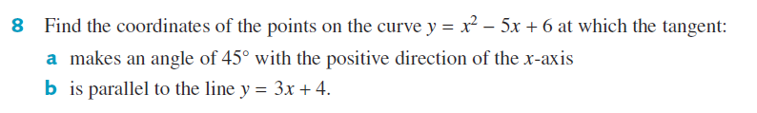

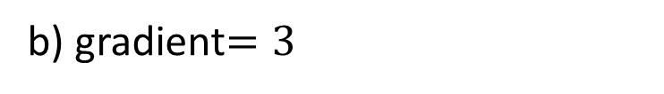











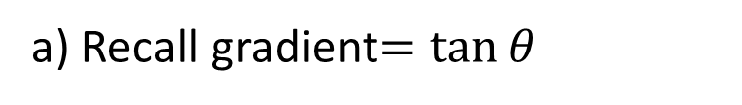


Guided Practice
a) Recall gradient$=\tan{θ}$
b) gradient$=3$
$∴$ gradient$=\tan{45°}=1$
$$3=2x−5$$
$$\frac{dy}{dx}=2x−5$$
$$x=4$$
$$1=2x−5$$
Subst $x=4$ into $y$
$$x=3$$
$y={\left(4\right)}^{2}−5\left(4\right)+6$
Subst $x=3$ into $y$
$$y=2$$
$y={\left(3\right)}^{2}−5\left(3\right)+6$
$$∴(4,2)$$
$y=0$
$$∴(3,0)$$

Slide 8

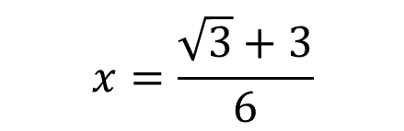

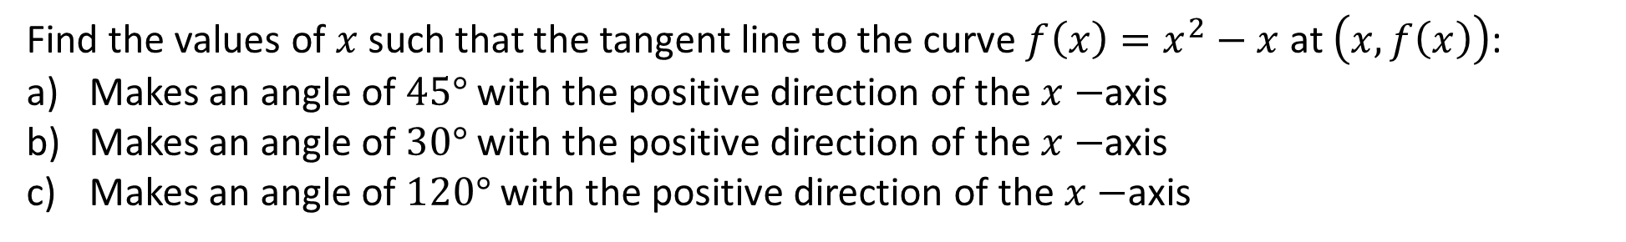

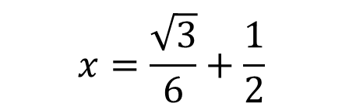


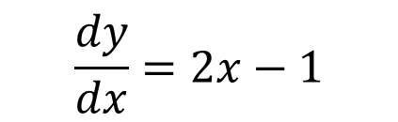
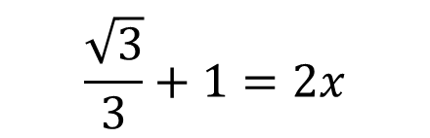
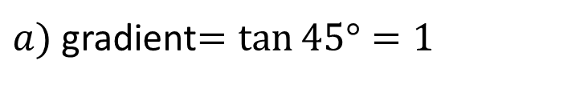

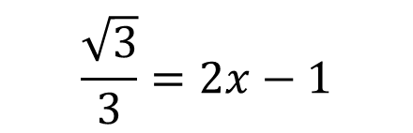
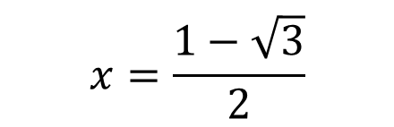

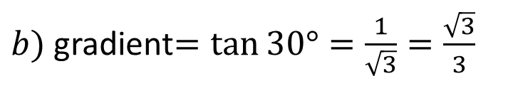
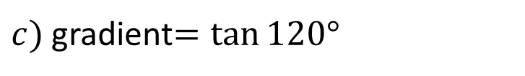
Guided Practice
Find the values of $x$such that the tangent line to the curve $f\left(x\right)=x^{2}−x$ at $\left(x, f\left(x\right)\right)$:
Makes an angle of $45°$ with the positive direction of the $x−$axis
Makes an angle of $30°$ with the positive direction of the $x−$axis
Makes an angle of $120°$ with the positive direction of the $x−$axis
$$\frac{dy}{dx}=2x−1$$
$b)$ gradient$=\tan{30°}=\frac{1}{\sqrt{3}}=\frac{\sqrt{3}}{3}$
$$\frac{\sqrt{3}}{3}=2x−1$$
$c)$ gradient$=\tan{120°}$
Recall gradient$=\tan{θ}$
$$=−\tan{60°}$$
$a)$ gradient$=\tan{45°}=1$
$$\frac{\sqrt{3}}{3}+1=2x$$
$$=−\sqrt{3}$$
$$1=2x−1$$
$$x=1$$
$$x=\frac{\sqrt{3}}{6}+\frac{1}{2}$$
$$−\sqrt{3}=2x−1$$
$$2x=1−\sqrt{3}$$
$$x=\frac{\sqrt{3}+3}{6}$$
$$x=\frac{1−\sqrt{3}}{2}$$

Slide 9
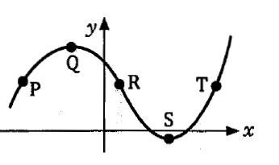
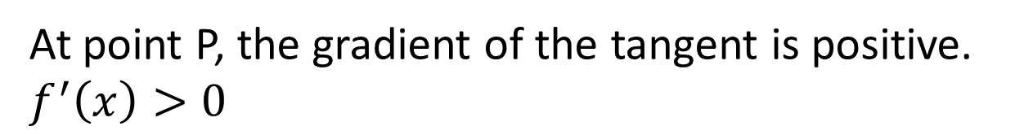

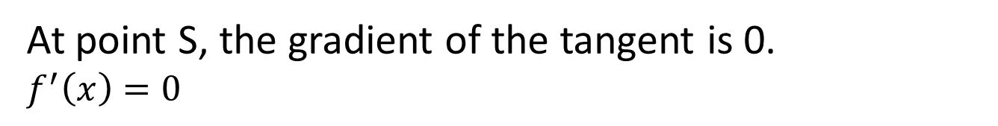
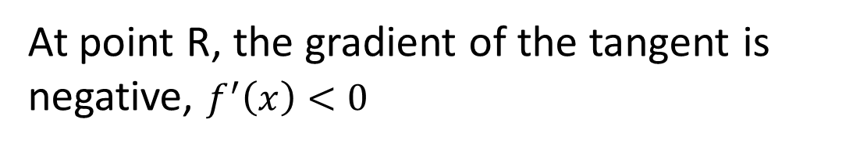
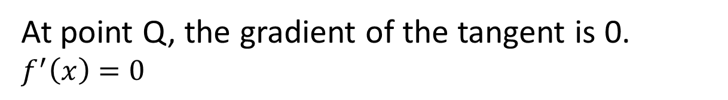
Activating Prior Knowledge
Consider the graph and determine the positive or negative nature of the gradient of the curve at points, P, Q, R, S, T
At point P, the gradient of the tangent is positive. $f^{′}\left(x\right)>0$
At point Q, the gradient of the tangent is 0.
$f^{′}\left(x\right)=0$
At point R, the gradient of the tangent is negative, $f^{′}\left(x\right)<0$
At point S, the gradient of the tangent is 0.
$f^{′}\left(x\right)=0$
At point T, the gradient of the tangent is positive
$$f^{′}\left(x\right)>0$$

Slide 10
Activating Prior Knowledge
If $f^{′}\left(x\right)>0$, for all x in the interval $⇒$ the function is strictly increasing
If $f^{′}\left(x\right)<0$ for all x in the interval $⇒$ the function is strictly decreasing
If $f^{′}\left(x\right)=0⇒$ there exist a minimum or maximum turning point

Slide 11
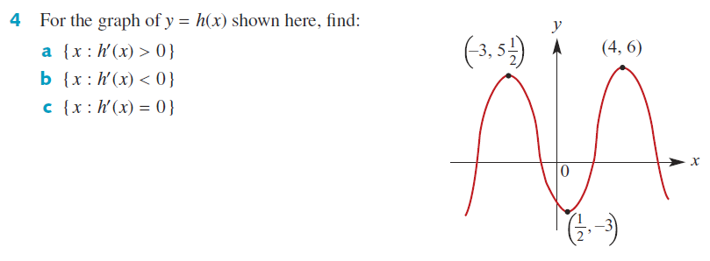
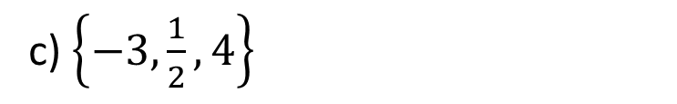
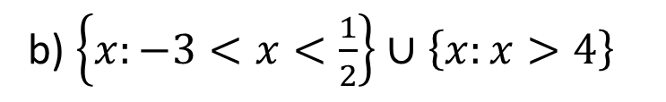
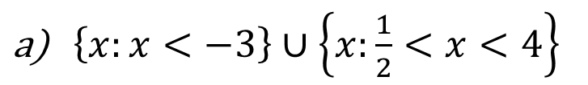
Guided Practice
$\left\{x:x<−3\right\}∪\left\{x:\frac{1}{2}<x<4\right\}$
b) $\left\{x:−3<x<\frac{1}{2}\right\}∪\left\{x:x>4\right\}$
c) $\left\{−3,\frac{1}{2}, 4\right\}$

Slide 12
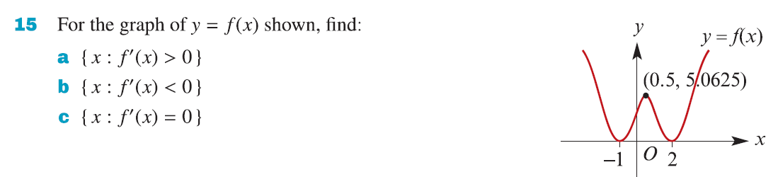
Guided Practice
a) $\left\{x:−1<x<0.5\right\}∪\left\{x:x>2\right\}$
b) $\left\{x:x<−1\right\}∪\left\{x:0.5<x<2\right\}$
c) $\left\{−1, 0.5, 2\right\}$

Slide 13
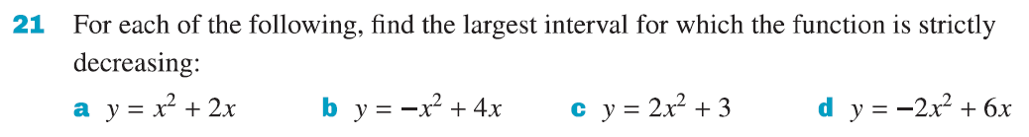


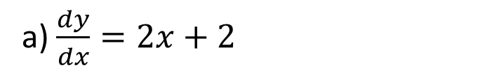




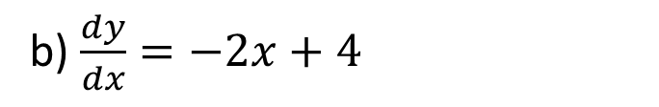


Guided Practice
a) $\frac{dy}{dx}=2x+2$
b) $\frac{dy}{dx}=−2x+4$
Consider the stationary points $\frac{dy}{dx}=0,$ $$0=2x+2$$
Consider the stationary points $\frac{dy}{dx}=0,$ $$0=−2x+4$$
$$x=−1$$
$$x=2$$
Consider when $x<−1, f^{′}\left(−2\right)<0$
Consider when $x<2, f^{′}\left(1\right)>0$
Consider when $x>−1, f^{′}\left(0\right)>0$
Consider when $x>2, f^{′}\left(3\right)<0$
Strictly decreasing interval $\{x:x<−1\}$
Strictly decreasing interval $\{x:x>2\}$

Slide 14
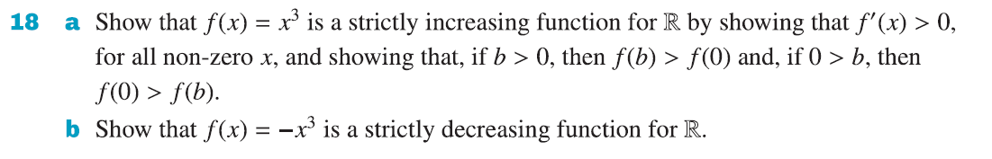
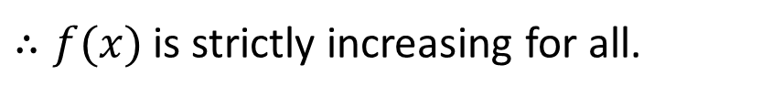
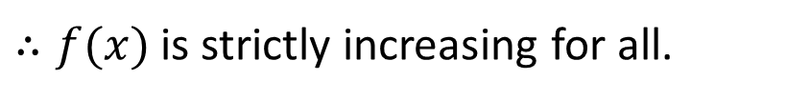
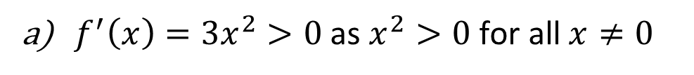


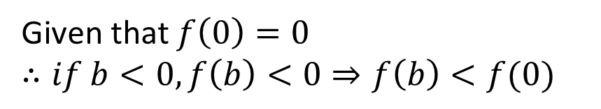
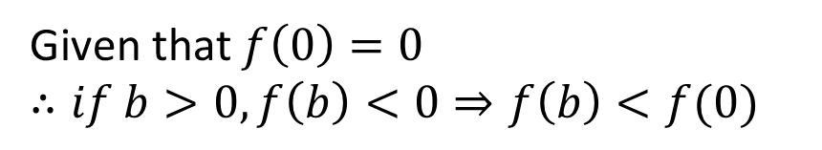
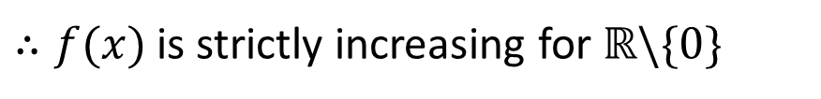
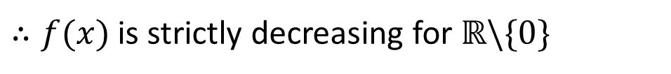
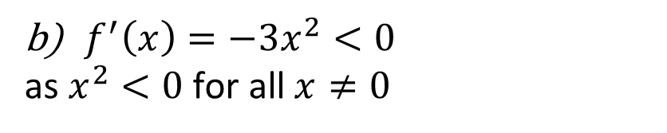
Guided Practice
$f^{′}\left(x\right)=3x^{2}>0$ as $x^{2}>0 \text{for} \text{all} x≠0$
$f^{′}\left(x\right)=−3x^{2}<0$
as $x^{2}<0 \text{for} \text{all} x≠0$
$∴f(x)$ is strictly increasing for $ℝ\backslash \{0\}$
$∴f(x)$ is strictly decreasing for $ℝ\backslash \{0\}$
Given that $f\left(0\right)=0$
$∴if b<0, f\left(b\right)<0⇒f\left(b\right)<f(0)$
Given that $f\left(0\right)=0$
$∴if b>0, f\left(b\right)<0⇒f\left(b\right)<f(0)$
$if b>0, f\left(b\right)>0⇒f\left(b\right)>f(0)$
$∴f(x)$ is strictly increasing for all.
$if b<0, f\left(b\right)>0⇒f\left(b\right)>f(0)$
$∴f(x)$ is strictly increasing for all.

Slide 15
Independent Practice
Complete Cambridge Ex 4B

